Slide 1


DATA PREPARATION
Presented by:ANGELO MAMMANA, JOGINDER SINGH E LEONARDO FANTIN

Slide 2


Index
1
2
3
ALTERYX
PIPELINE
RESULTS
Data Ingestion and discovery
Data Validation
Data Structuring
Data Enrichment
Data Filtering
Data Cleaning
Final pipeline
Datasets obtained
Conclusion
Overview
How it works
Learning Datasets
Pros and cons
Notes:
let's start with an general overview

Slide 3

1
Overview
Alteryx is a data science and business intelligence platform that provides tools for data analysis, report creation, and predictive modeling. It features capabilities such as data processing, cleaning, and preparation, statistical analysis, and the creation of interactive dashboards.
It is designed to be used by non technical users, making it a popular option for businesses looking to analyze their data.
Notes:
Alteryx is a powerful data preparation option
The software offers- an automated approach:
to preparing
cleansing
analyzing datasets

Slide 4

1
How it works
Alteryx includes a drag and drop interface that allows users to create workflow for data processing, analysis, and report creation. Users can import data from various sources, such as excel format and CSV files
Once the data is processed, users can utilize predictive models and statistical analysis features to generate insights that can inform business decisions
Notes:
in addition , Alteryx use a drag and drop interface -----that allows--- to create a workflow for data processing
moreover/always
The users can import a various sources, such as:
-excel format and csv files
so it’s very useful

Slide 5


1
Learning Datasets
Dataset about crimes
Dataset about retail sales
Notes:
To understand better alteryx
We used two different datasets.
The first was about crimes
and the second about retail

Slide 6













1
Tools used
Input
Browse
Output
Data
Cleasing
Formula
Filter
Sort
Select
Unique
TextBox
Join
Summarize
Summary
Report
Notes:
allowed us to
In particular, in this slide there are the tools ---that we used most
we have
- input operator: to import the data
- browse: to see the results
then, we have
- formula: to create or update the columns with operations
- sort: to order the records for something
- select: to select some features
- filter: The Filter divides the data in 2 flows.
----and the Records that satisfying the condition go on the flux true
- join operator: to do a join between data
and
- summarize: like a group by on SQL. Summarize infact groups and counts the data
is used for grouping or counting data
example of tool scrivere -> most used tool

Slide 7
1
Pros and Cons
High pricing for some organizations
it is not possible to define global variables
Complexity in transitioning from SQL to Alteryx for some advanced functionality
Intuitive and easy to use interface, allowing even non expert users to create complex data analysis workflows
Offers proprietary formats like 'yxdb' that we used to write and read data
Advanced data preparation tools, including join, union, cleaning, and data transformation
Support for a wide variety of file formats, including Excel, CSV, JSON, and SQL
Notes:
--------------------------------------
[Alteryx doesn’t include stored procedure as native functionality. so one of the possibility is to do with plug in
sono script di SQL per automatizzare alcune attività dei dati]
--------------------------------------
The benefits about Alteryx are:
-for sure, has a user-friendly interface
-includes very nice --some operators --like join and union
-It supports many format files
such as excel, JSON and CSV
Whereas the problem are:
-the price of alteryx because is expensive
-is not possible to define global variables(comparated to sql)
-it’s complex to change from SQL to Alteryx ---for some functionality --such as stored procedure

Slide 8
Index
1
2
3
ALTERYX
PIPELINE
RESULTS
Data Ingestion and discovery
Data Validation
Data Structuring
Data Enrichment
Data Filtering
Data Cleaning
Final pipeline
Datasets obtained
Conclusion
Overview
How it works
Learning Datasets
Pros and cons

Slide 9
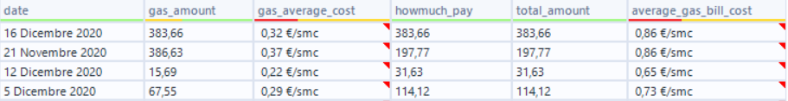
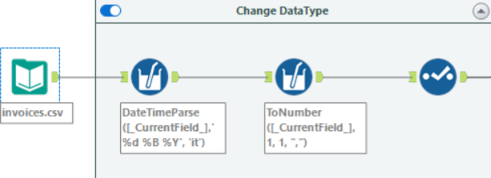


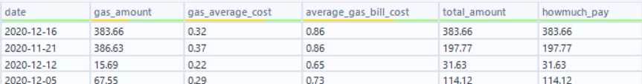
2
Data ingestion and discovery
Column Cleaning
Notes:
The first step in being able to start exploring our data was to clean the data and assign it a correct datatype. So we convert dates into ISO standard format (yyyy-mm-dd) with the help of RegEx and standardize numbers with decimals.

Slide 10
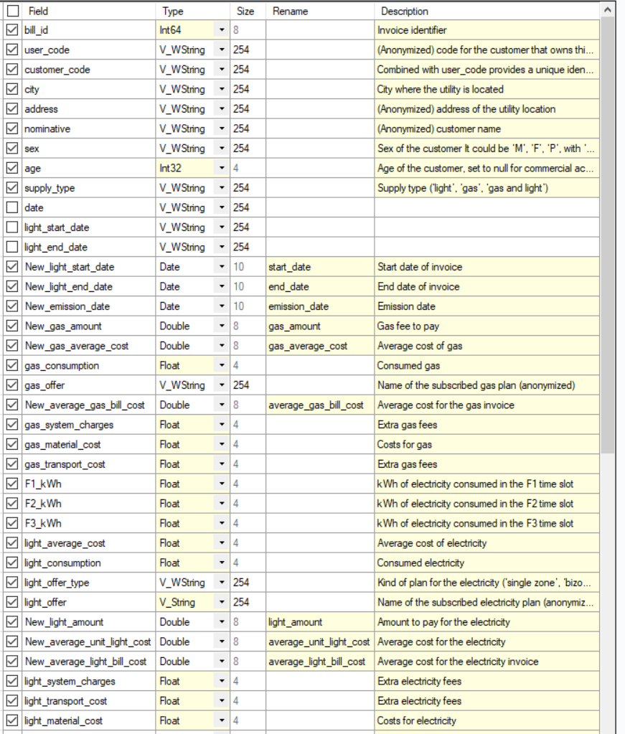
2
Data ingestion and discovery
Column Casting
Notes:
We assign the correct data type and we also removed the old columns for dates and numerical values ​​that we have previously calculated, always with select we have put a description to our columns.

Slide 11
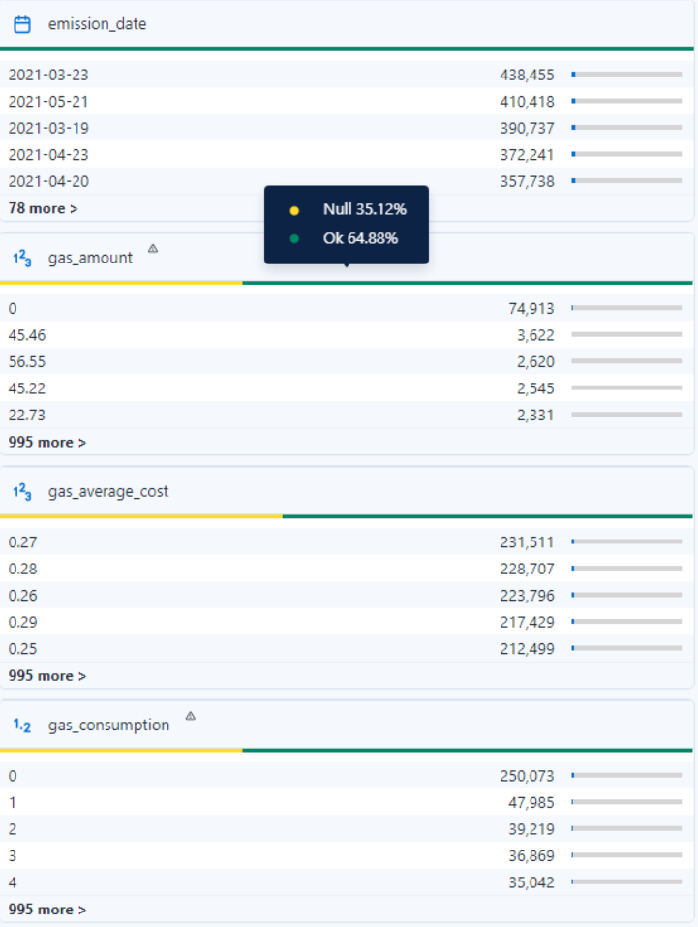
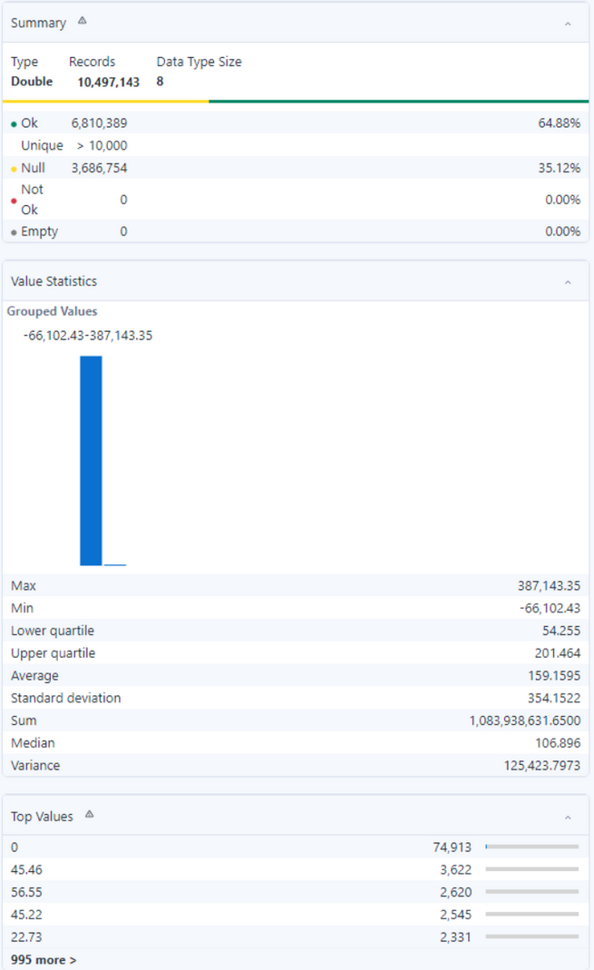
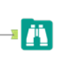
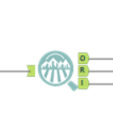
2
Data ingestion and discovery
Locate Missing Values
Notes:
Alteryx provide automatic summarization of data. We can see if our data are compliance to the datatype of field. Check how many unique values we have or null values. Also show us the statistical rappresetation of our data like min, max, Std. Deviation

Slide 12

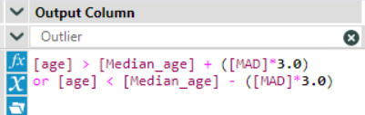
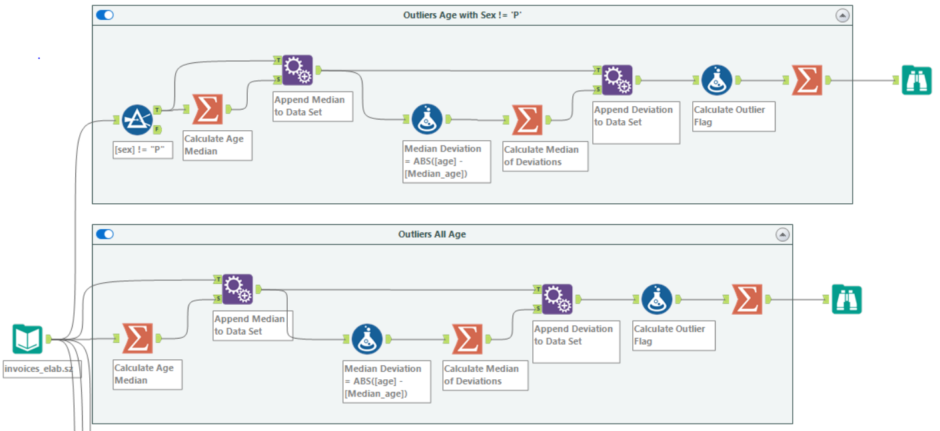



2
Data ingestion and discovery
Locate Outliers
Notes:
One of the things we noticed early on is that alteryx provides many simple functions but lacks many complex functions. One of these was to detect outlayers in the dataset.
Browsing the alteryx community we found that many advised to do it by hand. So we did this pipeline which allowed us to compute the outlayers in our data. For us, the only data where it made sense to do so was Age.

Slide 13
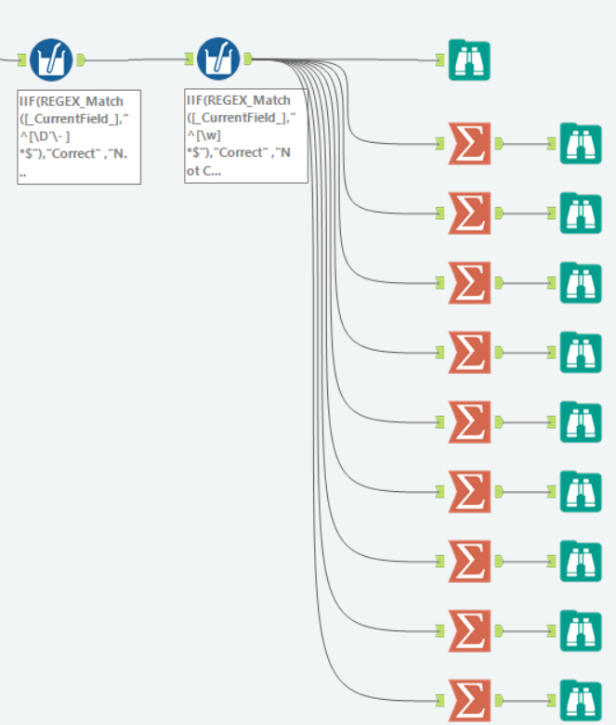
2
Data Validation
Check permitted characters
Notes:
On text type fields we checked the allowed characters through the use of RegEx which gave us if the characters followed the indicated pattern
Letter, Upper Dash
Alfanumeric

Slide 14
2
Data Validation
Check data range
«age» column have 111689(1,06% of the dataset) rows with value < 18
The column ‘total_amount’ defined as the sum of 'light_amount', 'gas_amount' and 'extra_fees’ is correct
The column 'howmuch_pay' is defined as the sum of 'tv' and total_amount’. incorrect values: 257825 (2,46% of the dataset) and will be correct in Data Enrichment step
For Numeric attributes having values less than zero
F1_kWh
F2_kWh
F3_kWh
tv
gas_amount
extra_fees
gas_consumption
light_consumption
howmuch_pay
103454 (0.99%)
96042 (0.91%)
93080 (0.89%)
384 (0.004%)
152185 (1.45%)
351630 (3.35%)
338653 (3.23%)
96921 (0.92%)
17 (0.00006%)
total_amount
light_amount
gas_system_charges
light_system_charges
gas_material_cost
light_material_cost
gas_transport_cost
light_transport_cost
31006 (0.3%)
30359 (0.3%)
2900681 (27,63%)
56722 (0.54%)
140490 (1.34%)
33499 (0.32%)
144439 (1.38%)
121300 (1.16%)

Slide 15
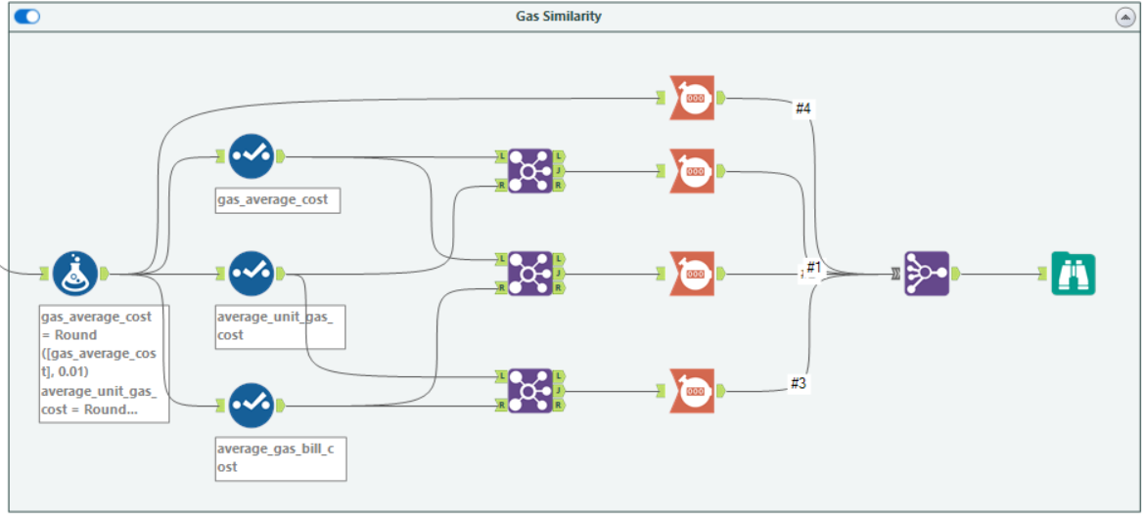
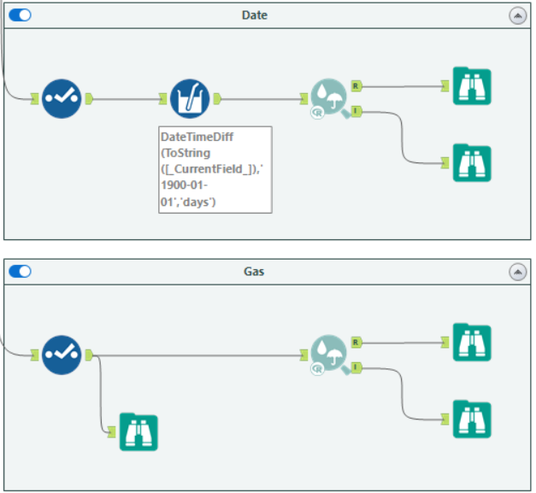
2
Data Validation
Check column uniqueness
OLD DUPLICATE COLUMN
REPLACEMENT COLUMN
date, light_start_date, gas_end_date
light_end_date, gas_start_date
gas_average_cost, average_unit_gas_cost
start_date
end_date
Notes:
We have the uniqueness check between fields of the same type and we have not considered the fields of text type because it was already noted that they were all different.
So for Dates and Numerics and numericals we have divided them in turn into Gas and Light.
A first check we calculated the correlation between the fields and where the correlation was 1 there could be similar fields. So the second solution was brute force where we compared the values ​​of the fields and calculated how similar they were.

Slide 16
2
Data Validation
Find data-mismatched data types
Notes:
Both columns are anonymized but for one it is recommended to put datatype String and other Float. We decided to put both strings so they were easy to read, otherwise with Float they can produce concerts in Exponential format.

Slide 17
2
Data Structuring
Change column datatype
gas_offer [float] -> gas_offer[string]
Delete column
date, gas_start_date, gas_end_date
Rename column
F1_kWh -> f1_kwh
F2_kWh -> f2_kwh
F3_kWh -> f3_kwh
light_start_date -> start_date
light_end_date -> end_date

Slide 18
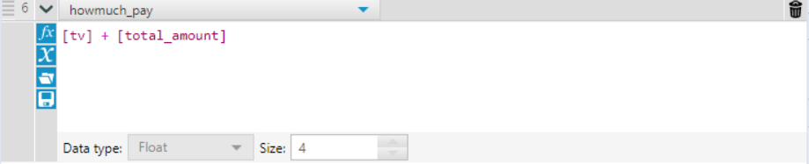
2
Data Enrichment
Since the data in the howmuch_pay column, calculated as the sum of 'total_amount' and 'tv', are wrong in 257825 (2,46% of the dataset), so we decided to re-calculate them to obtain the correct results.

Slide 19
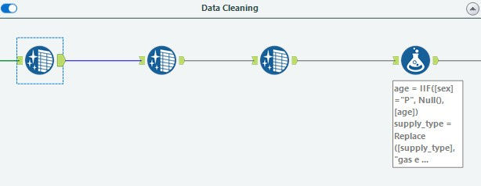
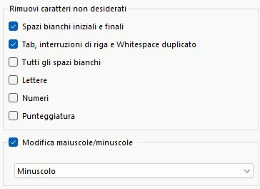

2
Data Cleaning
Adjusted the String characters
Converted null values to 0
Notes:
1° Sistemazione dei numeri.
Impostandoli a zero i valori nulli. Per la conversione da stringa a numero.
2° Abbiamo aggiusta il carattere delle stringe, lower case per tutti e title case per le città

Slide 20
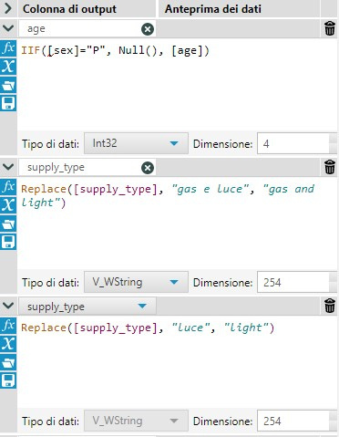

Set sex=P
Transalate the supply tupe
2
Data Cleaning
Set Title Case
Notes:
1° Sistemazione dei numeri.
Impostandoli a zero i valori nulli. Per la conversione da stringa a numero.
2° Abbiamo aggiusta il carattere delle stringe, lower case per tutti e title case per le città
3° Tolti gli spazi bianchi in iniziali, fondo e quelli in mezzo.
4° Standardizzazione delle stringe, supply type, messo in inglese.
5° Aggiustato dov'era false il supply type. messo a standard bill
6° Spit delle colonne e verifica del tipo di supply. es se gas, ligth messa Null e non viene più considerata.
7° Corretto light bizone

Slide 21
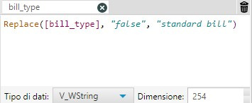
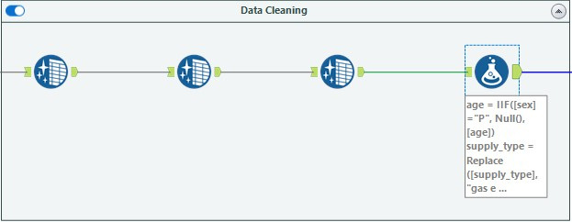
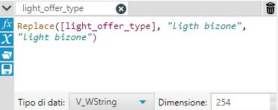
2
Data Cleaning
Set Null Supply Type to "standard bill"
Correct typo "light offer type"
Notes:
1° Sistemazione dei numeri.
Impostandoli a zero i valori nulli. Per la conversione da stringa a numero.
2° Abbiamo aggiusta il carattere delle stringe, lower case per tutti e title case per le città
3° Tolti gli spazi bianchi in iniziali, fondo e quelli in mezzo.
4° Standardizzazione delle stringe, supply type, messo in inglese.
5° Aggiustato dov'era false il supply type. messo a standard bill
6° Spit delle colonne e verifica del tipo di supply. es se gas, ligth messa Null e non viene più considerata.
7° Corretto light bizone

Slide 22
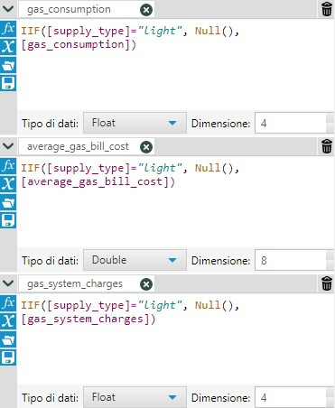
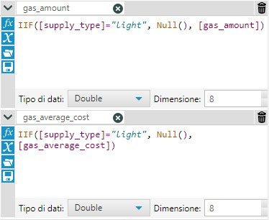
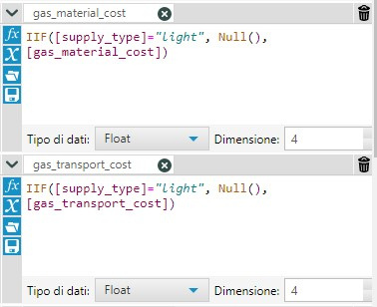
2
Data Cleaning
Light invoces set null gas fields
Notes:
1° Sistemazione dei numeri.
Impostandoli a zero i valori nulli. Per la conversione da stringa a numero.
2° Abbiamo aggiusta il carattere delle stringe, lower case per tutti e title case per le città
3° Tolti gli spazi bianchi in iniziali, fondo e quelli in mezzo.
4° Standardizzazione delle stringe, supply type, messo in inglese.
5° Aggiustato dov'era false il supply type. messo a standard bill
6° Spit delle colonne e verifica del tipo di supply. es se gas, ligth messa Null e non viene più considerata.
7° Corretto light bizone

Slide 23
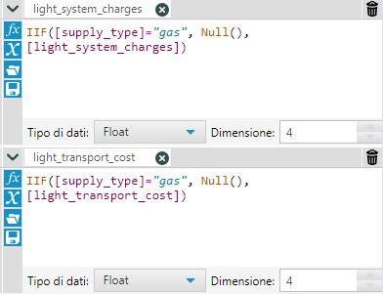
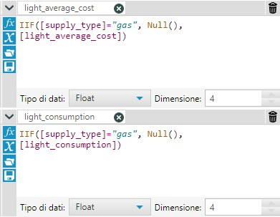
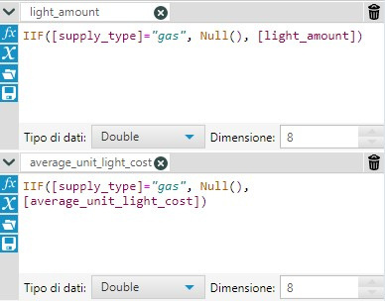
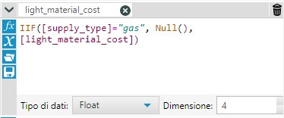
2
Data Cleaning
Gas invoces set null light fields
Notes:
1° Sistemazione dei numeri.
Impostandoli a zero i valori nulli. Per la conversione da stringa a numero.
2° Abbiamo aggiusta il carattere delle stringe, lower case per tutti e title case per le città
3° Tolti gli spazi bianchi in iniziali, fondo e quelli in mezzo.
4° Standardizzazione delle stringe, supply type, messo in inglese.
5° Aggiustato dov'era false il supply type. messo a standard bill
6° Spit delle colonne e verifica del tipo di supply. es se gas, ligth messa Null e non viene più considerata.
7° Corretto light bizone

Slide 24
Index
1
2
3
ALTERYX
PIPELINE
RESULTS
Data Ingestion and discovery
Data Validation
Data Structuring
Data Enrichment
Data Filtering
Data Cleaning
Final pipeline
Datasets obtained
Conclusion
Overview
How it works
Learning Datasets
Pros and cons

Slide 25
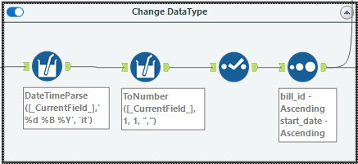
3
Final Pipeline
Data format correction
Notes:
- PRIMA PARTE
Correggiamo il formato delle date e i numeri.
Con il select andiamo a fare la conversione dei dati.

Slide 26
3
Final Pipeline
Data cleaning
Notes:
- SECONDA PARTE
Data cleaning

Slide 27
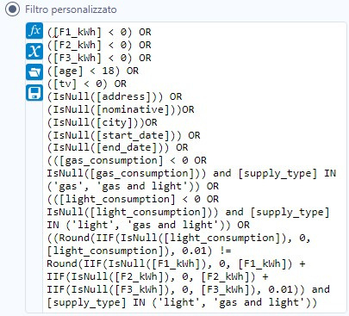
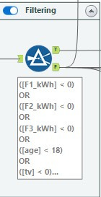
3
Final Pipeline
Check the condition
Notes:
1° filtro sono tolti i dati che non soddisfano i requisiti, perché considerati sbagliati e non validi
- TERZA PARTE
Filtro verifico che le condizioni siano soddisfatte e nel caso non lo siano li scarto

Slide 28
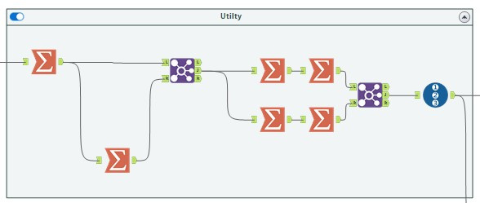
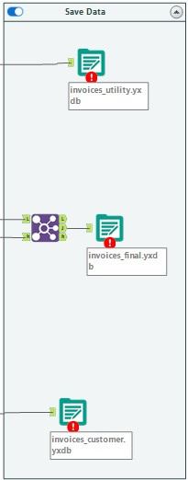
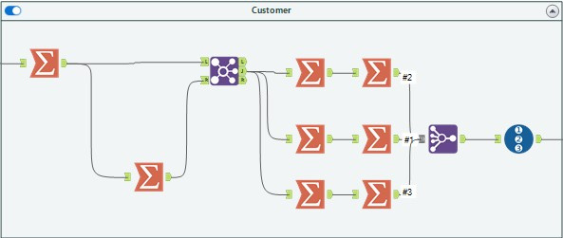
3
Final Pipeline
Creation of the 3 DBs
Notes:
- QUARTA PARTE
Creazione dei 3 DB e salvataggio.
Decisioni prese riguardo al DB utenti
prese le colonne selezionate (screenshot) e la data raggruppate per la chiava per prendere la data massima. Join su code user e costumer e la data. Con la tabella di partenza, per togliere i duplicati.
Ricontrollo se ci sono dei duplicati. Group by per la chiave sopra per togliere indirizzo e sotto per togliere città. Per togliere duplicati nelle concatenazioni.
Sotto per gestire l'età è stata fatta la ma la moda.
Join finale tra invoces e utility per sostituire la chiave. user_code e costumer_code
record-id che diventa utility code

Slide 29
3
Datasets obtained
Customer
3.898.716 of records
Utilty
4.967.519 of records
Invoices
9.781.634 of records
Pipeline execution time invoices is 15-30 minutes
Notes:
Ottenuti i 3DB
Formato del DB yxdb. LEGGI IL LINK: https://community.alteryx.com/t5/Data-Science/Benchmarking-Alteryx-Designer-against-Pandas-Preparing-for-the/ba-p/66228
più veloce, dimensioni compresse, un bel affare
Screnshot DB
DB utenti
concatenazione nel caso in cui per un utente ci siano più città
e anche l'address
DB Customer.
età mediana, sesso è preso l'ultimo e nel caso di doppio diverso si fa la concatenazione e nominativo non in chiaro quindi concateniamo.

Slide 30
3
Conclusion
Offers the possibility of caching the intermediate result
Execution times depend on hardware
Use the maximum resources available
AMP allows parallel pipeline execution
Great community
Does not offer complex tools.
Saves temporary files between steps on disk
Learning the interface and features may take time
Notes:
salva in ram e se non c'è spazio li salva sul disco.

Slide 31

Thanks for your attention!

